Slide 1

Econometric Property Investment Calculator

Slide 2
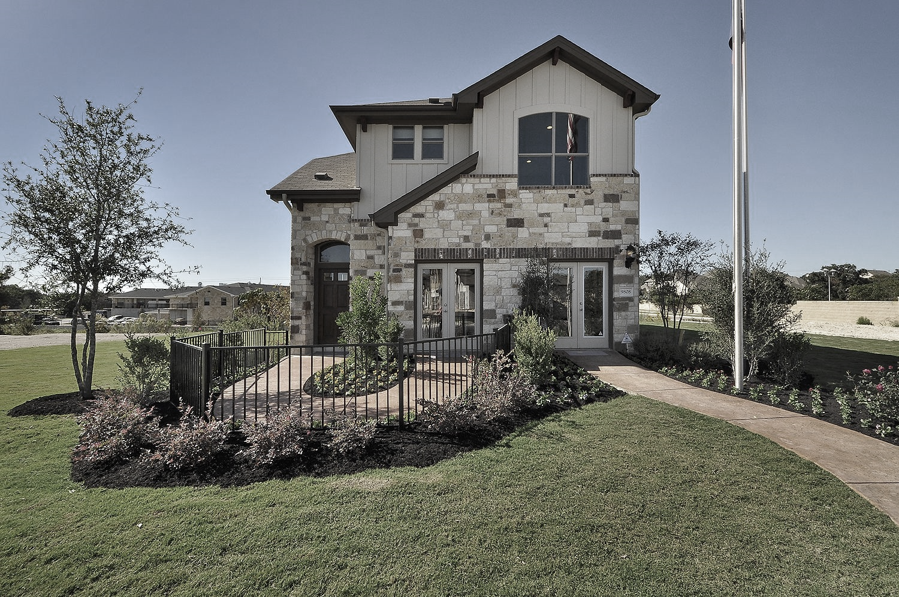
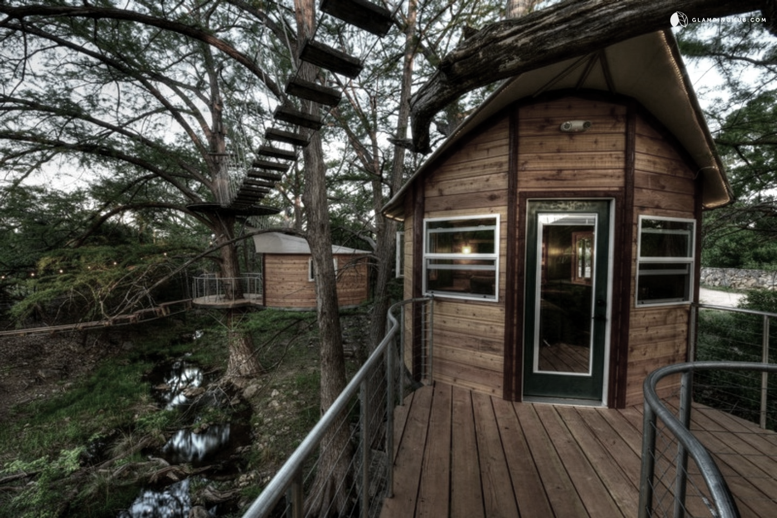
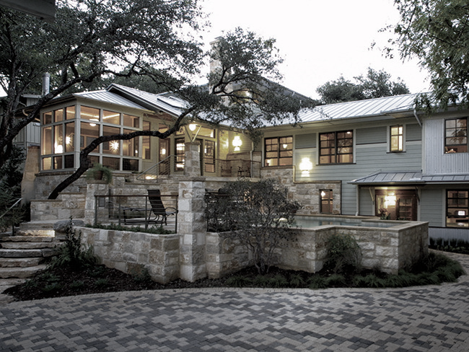
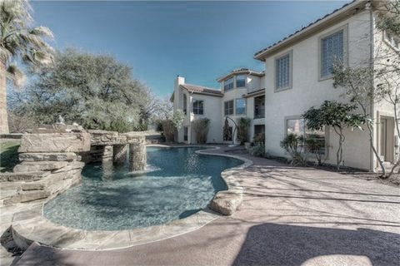
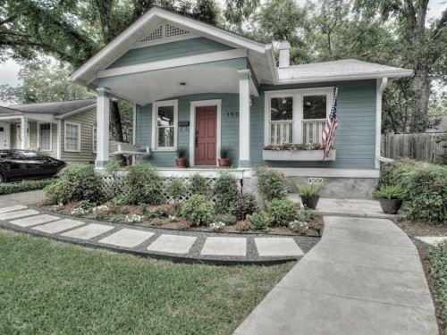
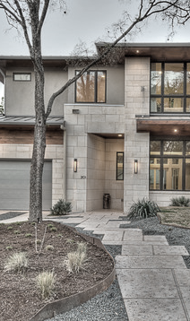
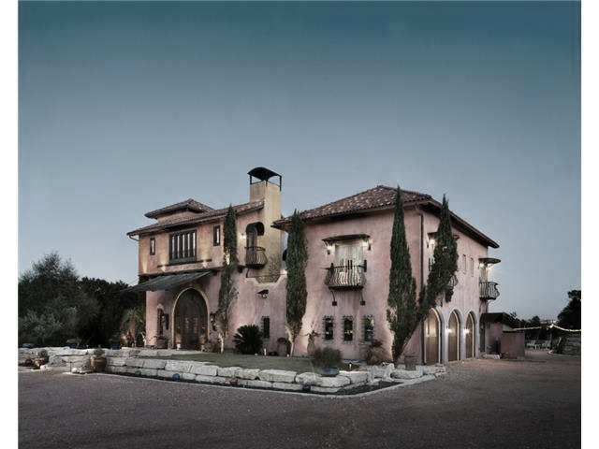

Austin real estate is booming!
But what are the factors driving property values?

Slide 3
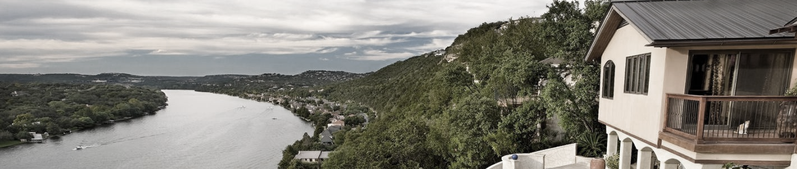






Data Sources
Zillow
City of
Austin
School Digger
US Census Bureau
Texas School Guide
OpenStreetMap

Slide 4
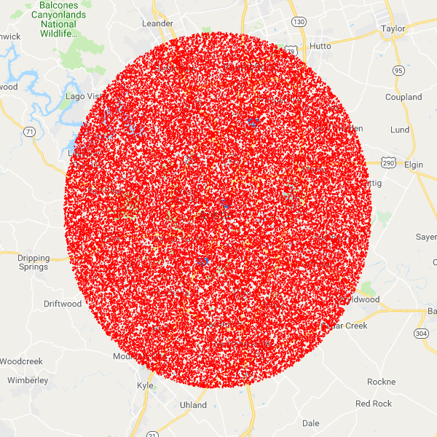

Random Geocoordinates

Slide 5
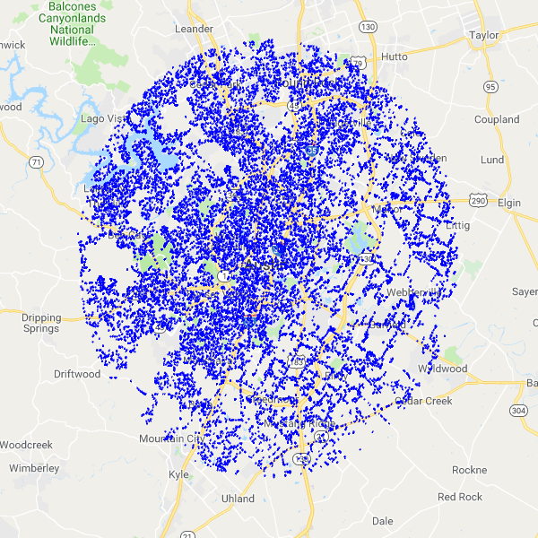
House Addresses
Random Geocoordinates

Slide 6
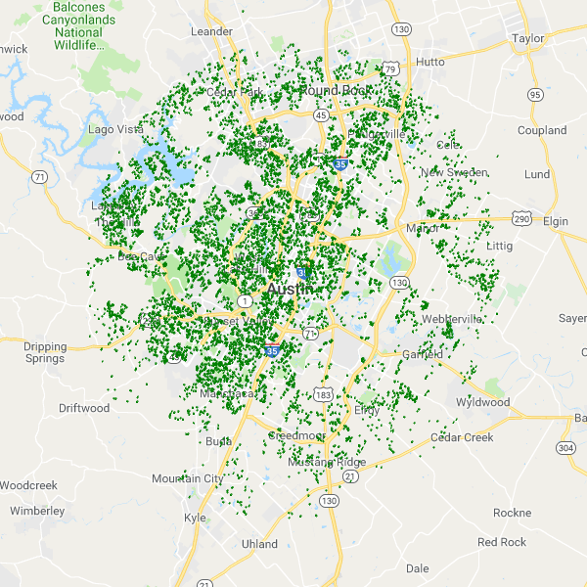
Property Info
Random Geocoordinates
House Addresses

Slide 7
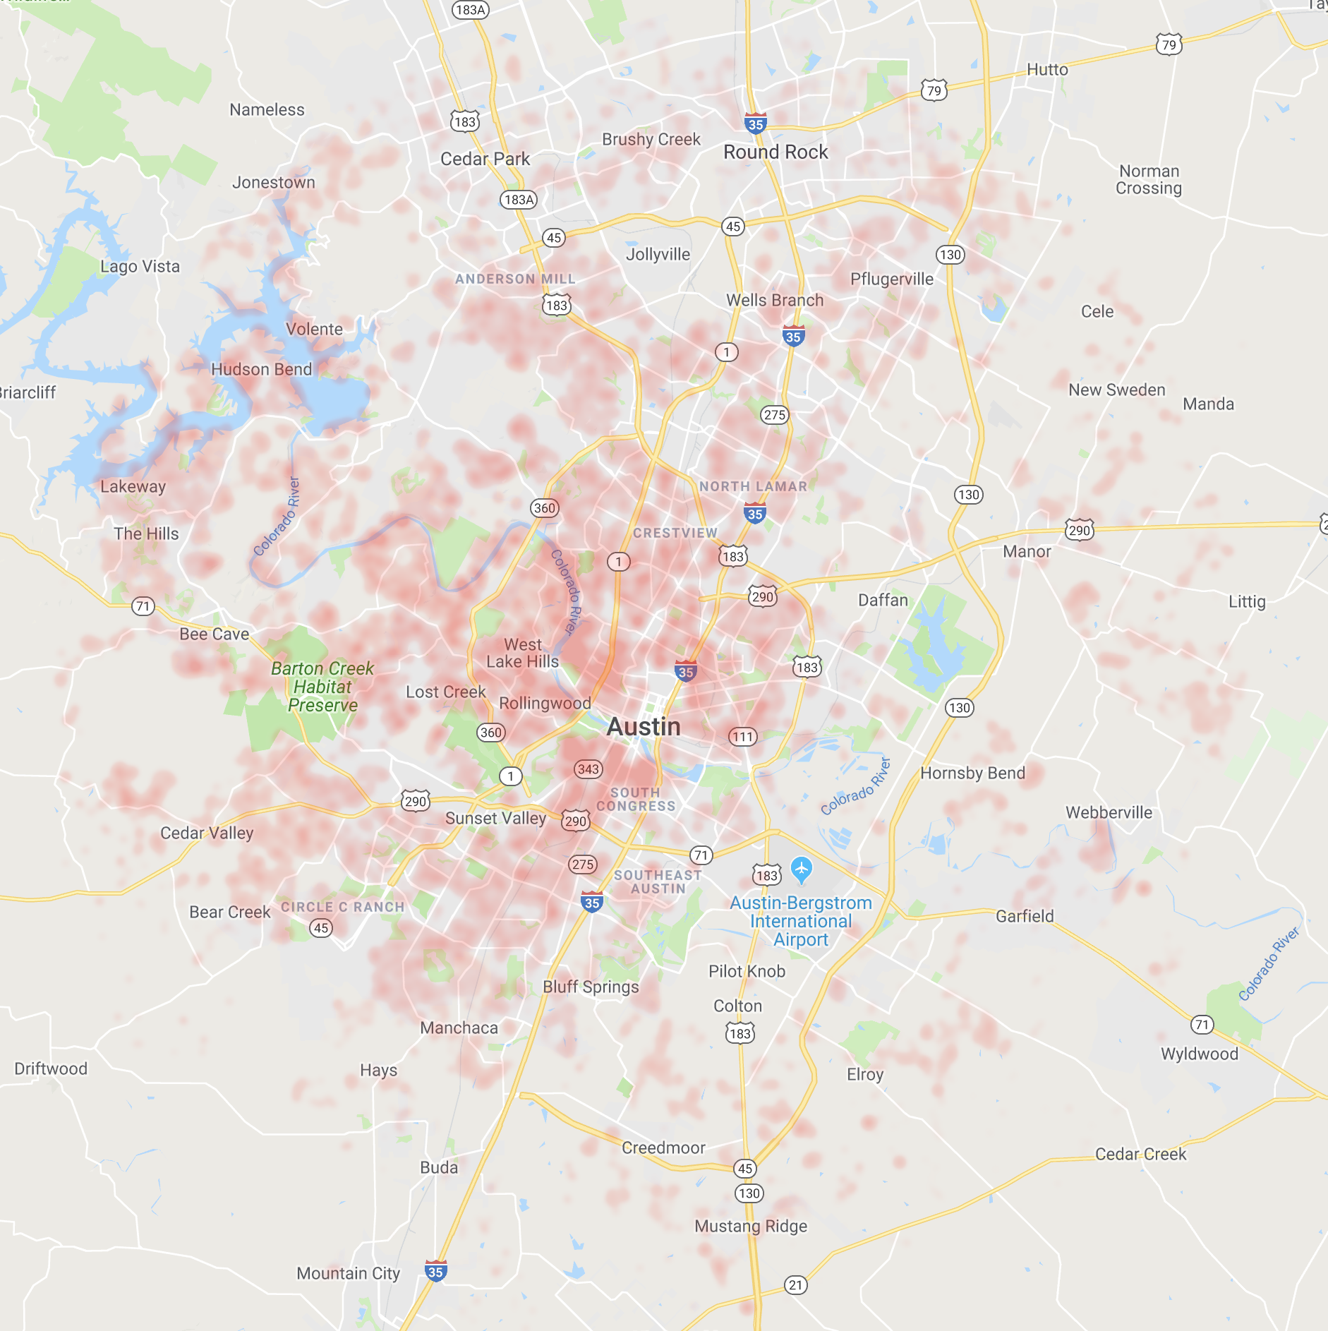
Property Value
Cheap
Expensive

Slide 8
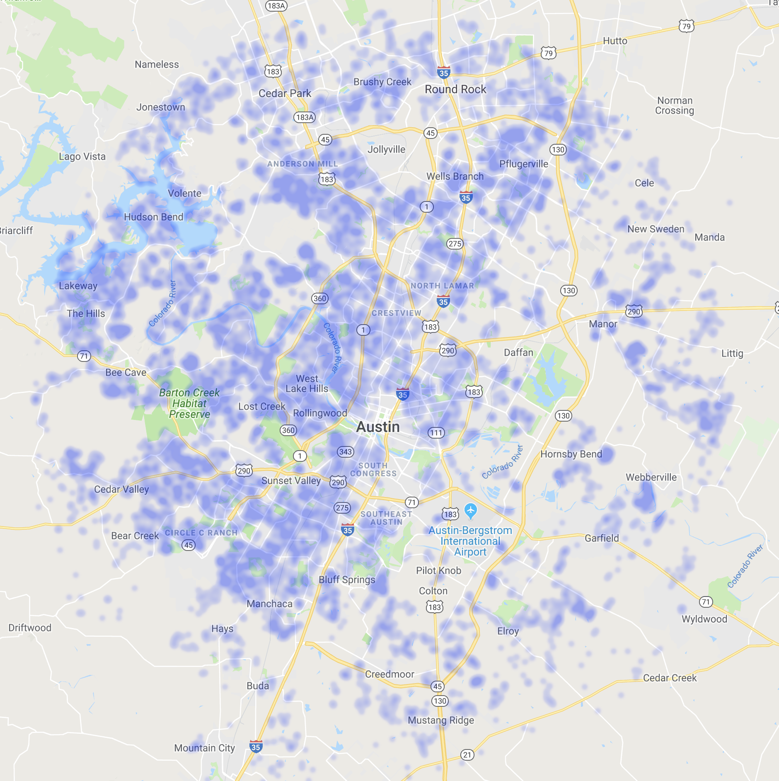
Safety Score
Unsafe
Safe

Slide 9
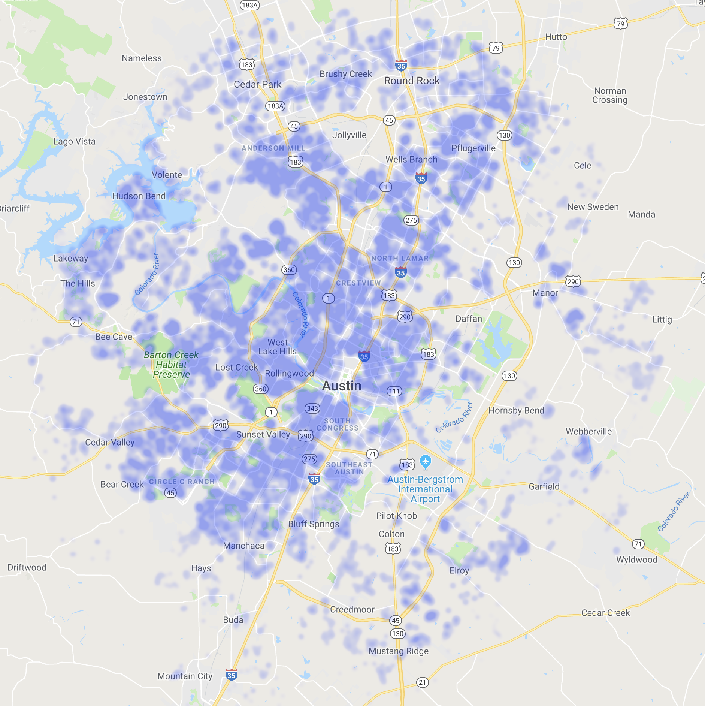
Commute Score
Long
Short

Slide 10
School Grade
Insert new heat map here with same dimensions
Low
High

Slide 11
Insert code diagram here

Slide 12
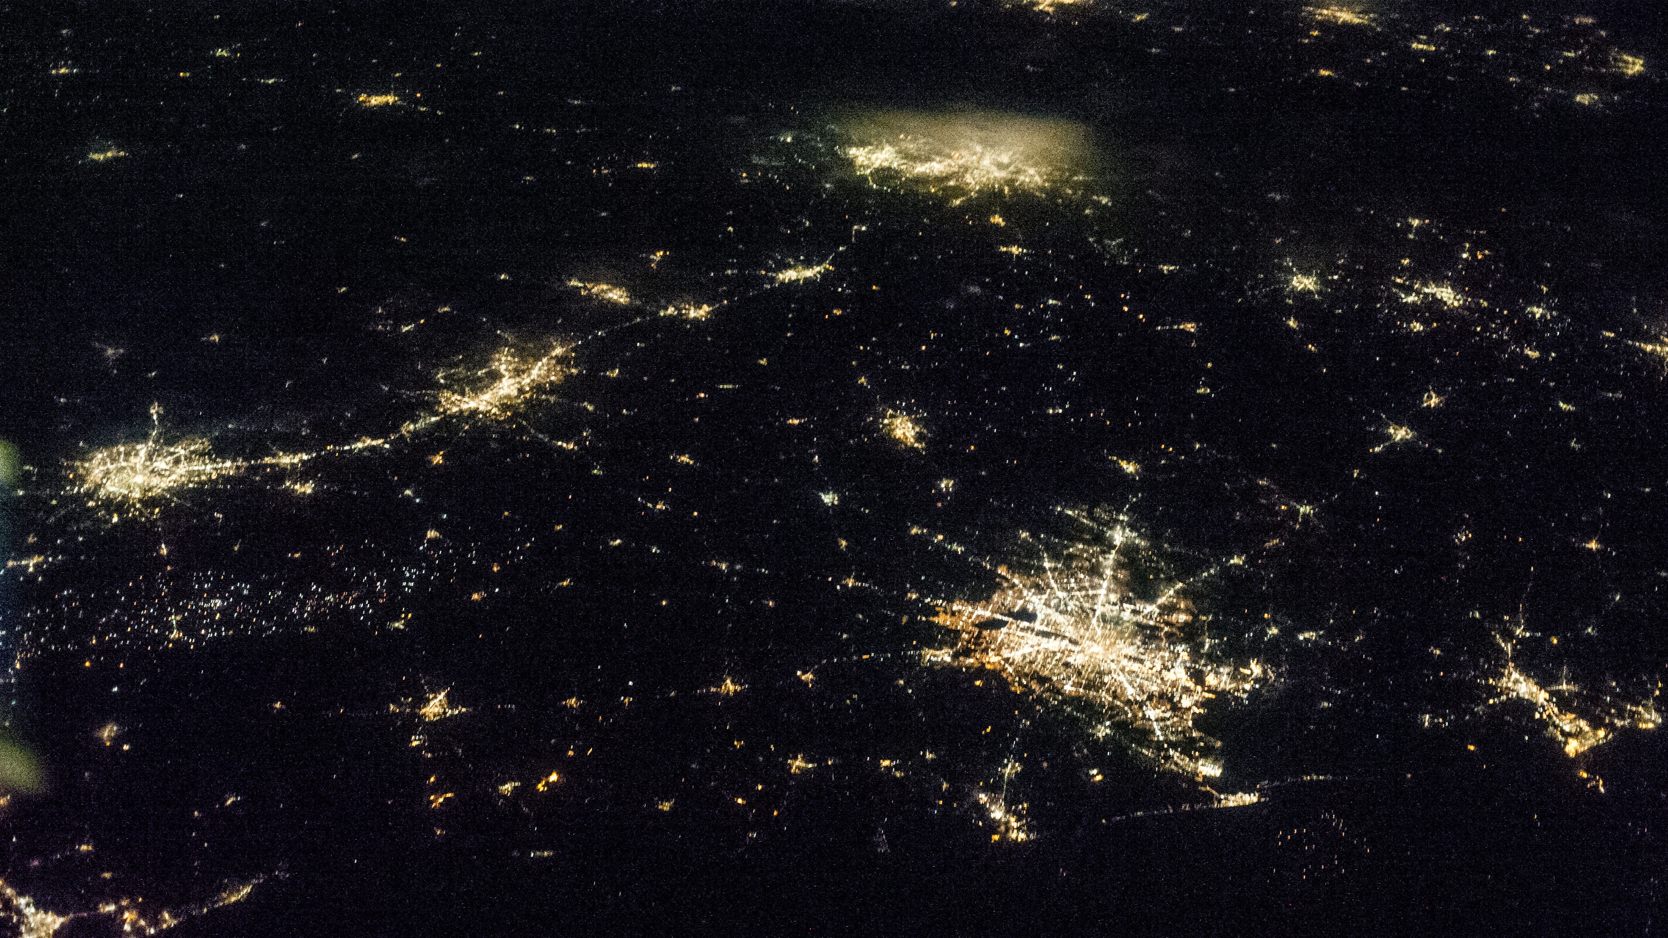
Analysis

Slide 13
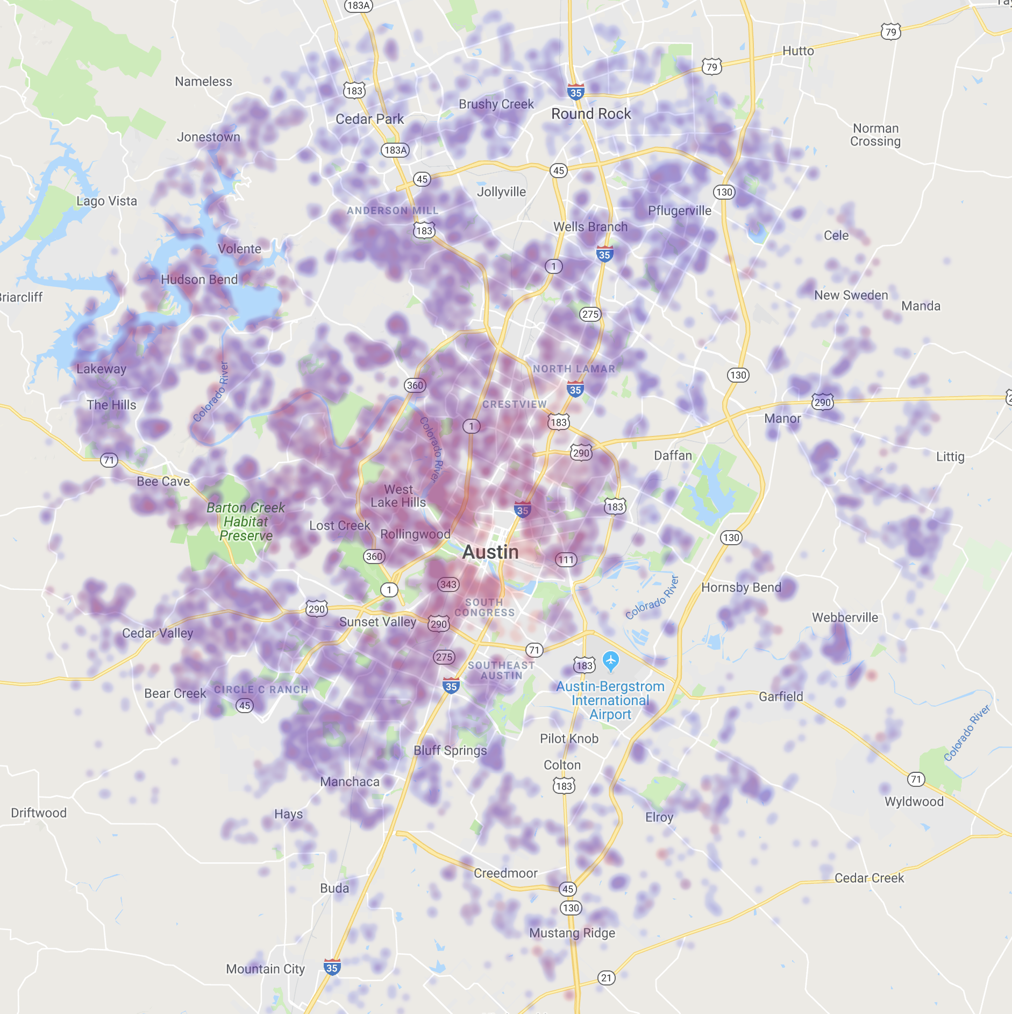
Crime vs Property Value
Property value does not take into account crime risk

Slide 14
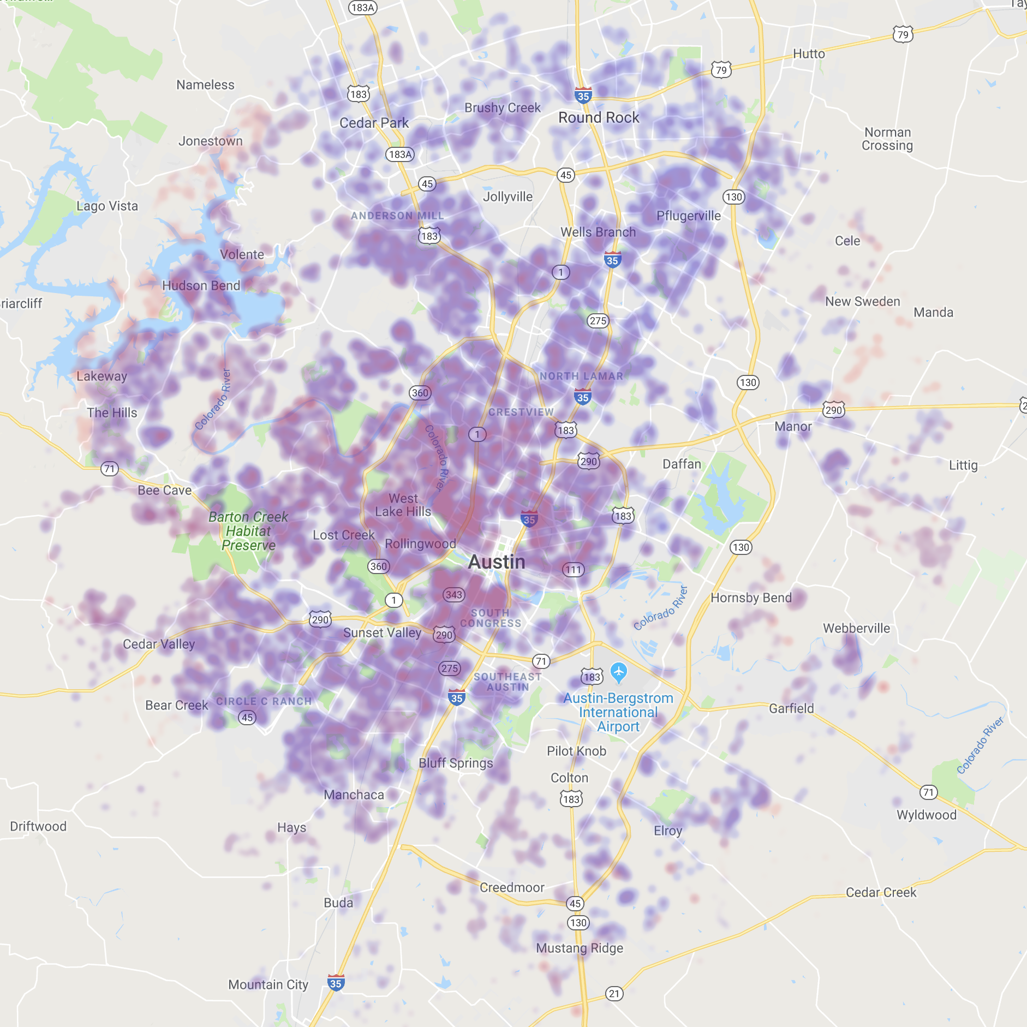
Commute vs Property Value
Property values and commute align with locations of big companies (galleria, downtown, northwest (Dell, GM, etc))

Slide 15
School Grade vs Property Value
Insert finding here

Slide 16





Really EPIC Team
Troy Bailey
Seth Bitney
Kat Pin
“That guy”
Meet the Team 05 peeps
Valerie Wilmot
Yuta Yamaguchi
The girl with the mermaid tail

